Slide 1
Histogram Processing
P.Hema Sree

Slide 2
Contents
What is Histogram
Histogram Processing
Histogram Stretching
Histogram Equalization
Histogram in MATLAB Prog
Histogram Specification
7/31/17
<number>

Slide 3
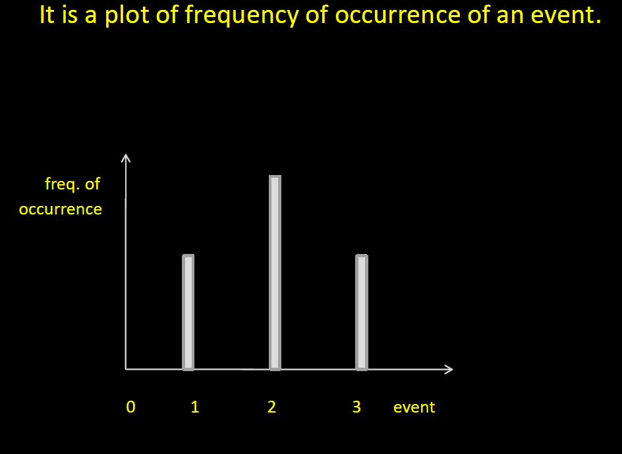
What is Histogram
7/31/17
<number>

Slide 4
Histogram Processing
Histogram of images provide a global description of their appearance
Enormous information is obtained
It is a spatial domain technique
Histogram of an image represents relative frequency of occurrence of various gray levels.
Histogram can be plotted in two ways
7/31/17
<number>

Slide 5
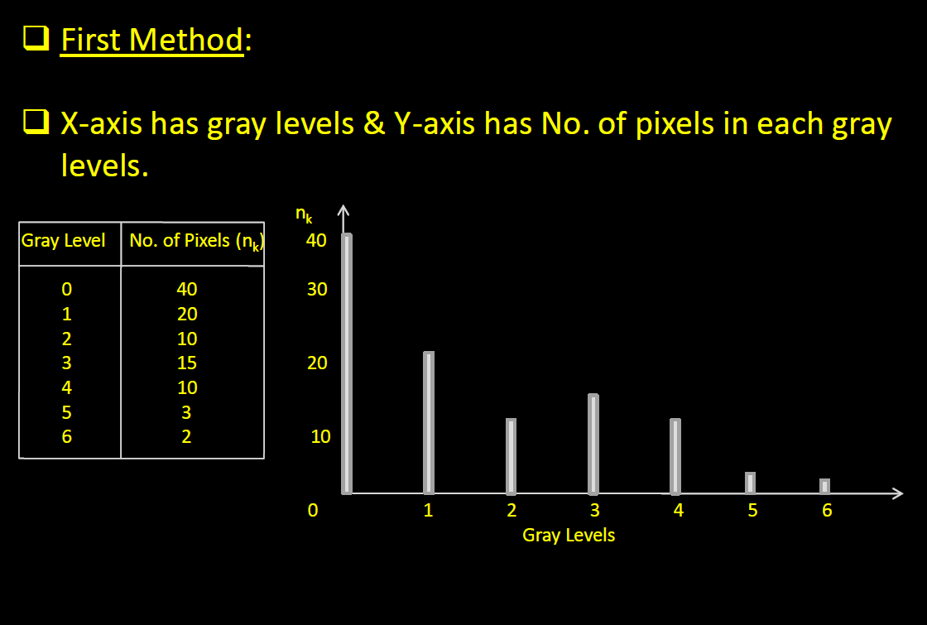
Histogram Processing
7/31/17
<number>

Slide 6
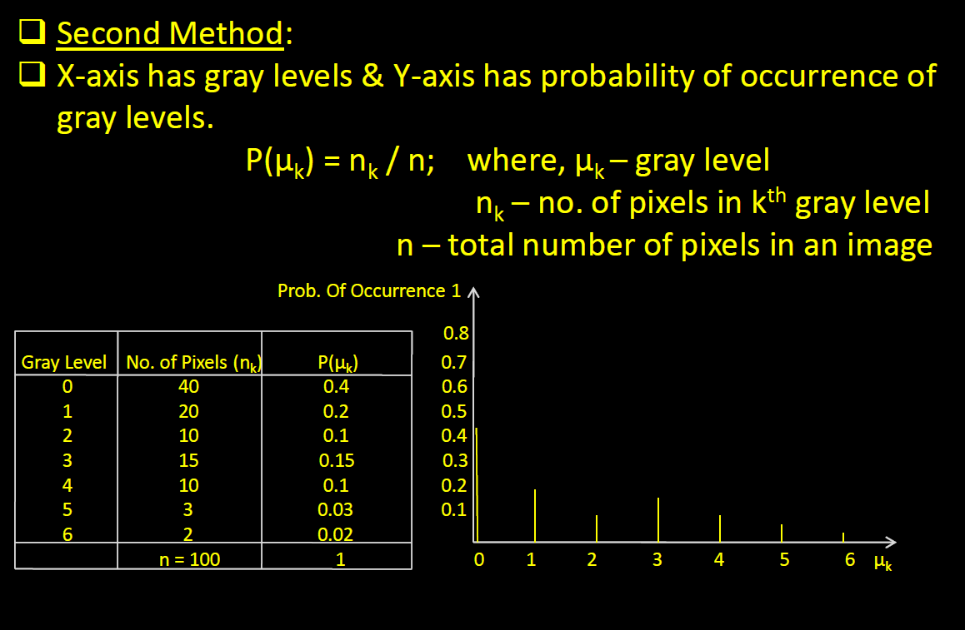
Histogram Processing
7/31/17
<number>

Slide 7
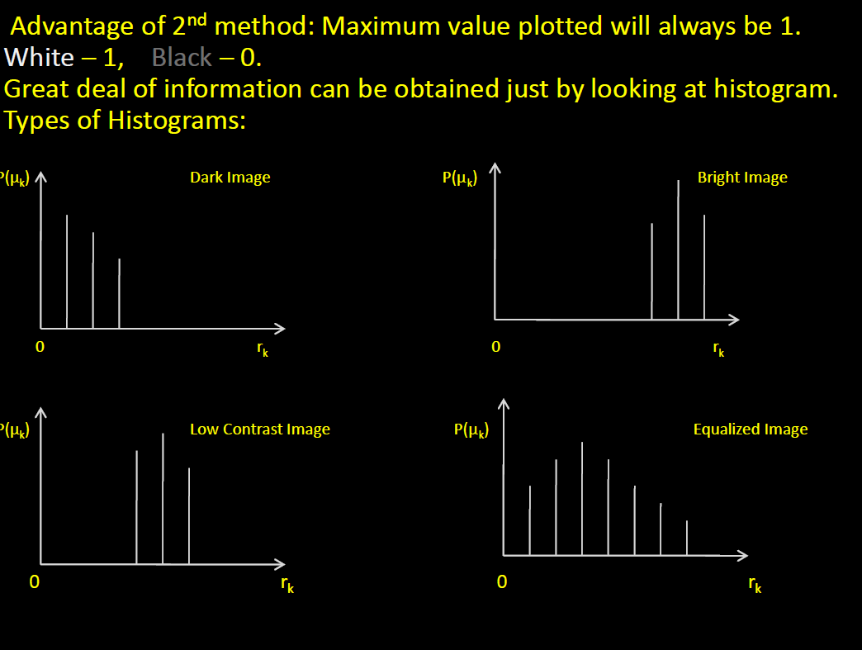
Histogram Processing
7/31/17
<number>

Slide 8
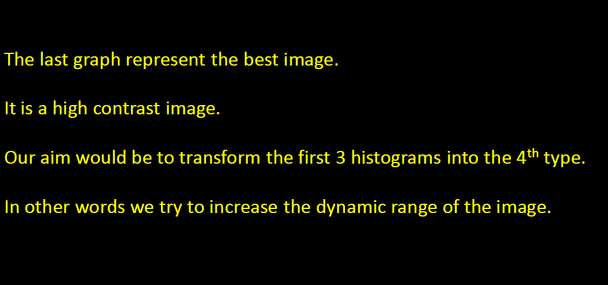
Histogram Processing
7/31/17
<number>

Slide 9
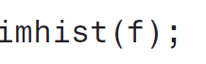
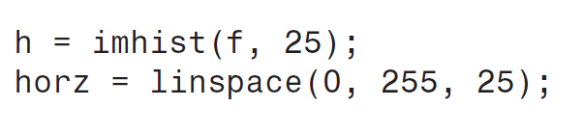
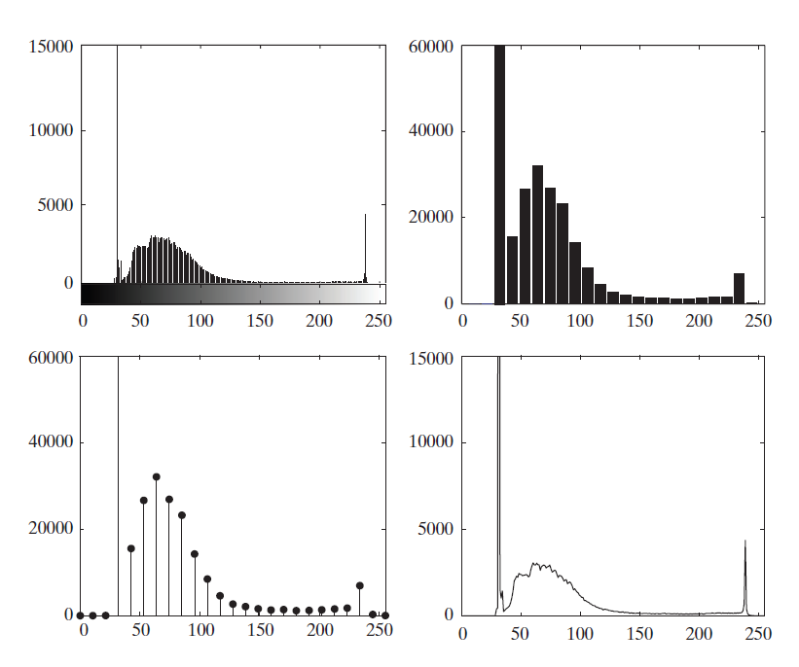
7/31/17
<number>

Slide 10
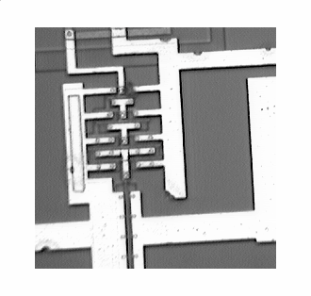
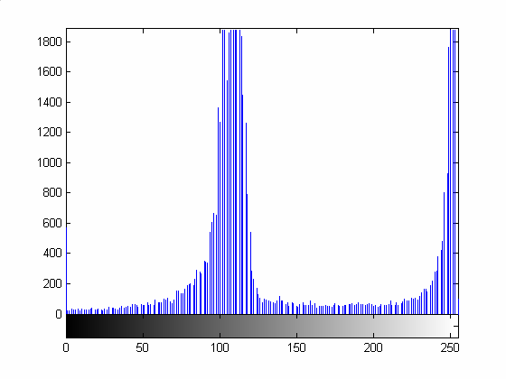
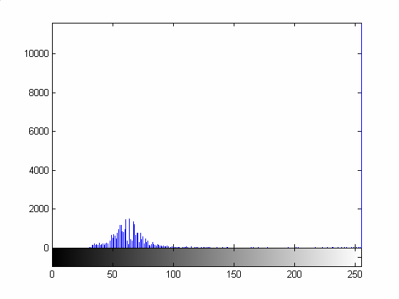
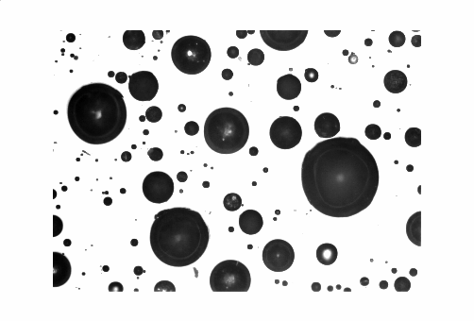
Some Images and their Histograms
Image with2 prominent intensities
7/31/17
Foreground white
<number>

Slide 11
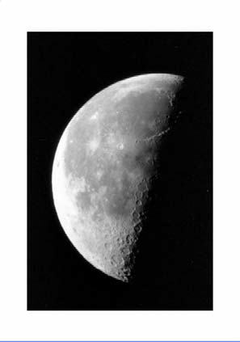
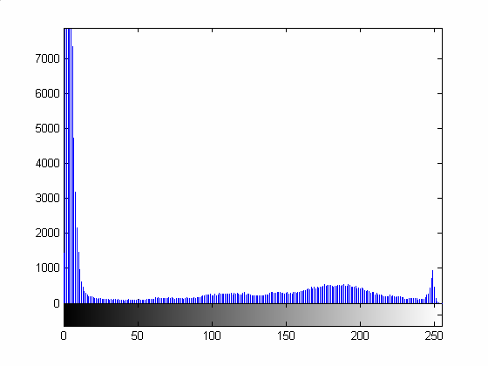
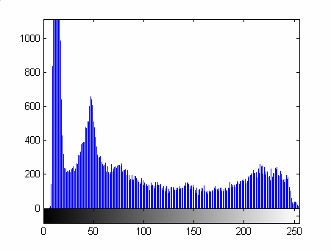
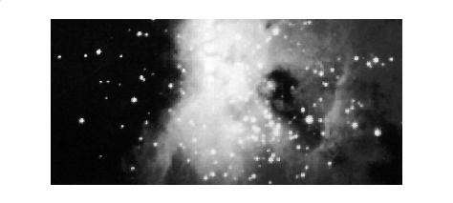
Image with more prominent dark background
7/31/17
Image with more or less uniform coloring except the background
<number>

Slide 12
Histograms: Example
7/31/17
<number>

Slide 13
Use of histogram
Use of histogram • Histograms are
simple to calculate
Give information about the kind (global appearance) of image and its properties.
• Used for Image enhancement
• Used for Image compression
• Used for Image segmentation
• Can be used for real time processing
We shall now have a look at Histogram Equalization:
Here, the goal is to obtain a uniform histogram for the output image.
7/31/17
<number>

Slide 14
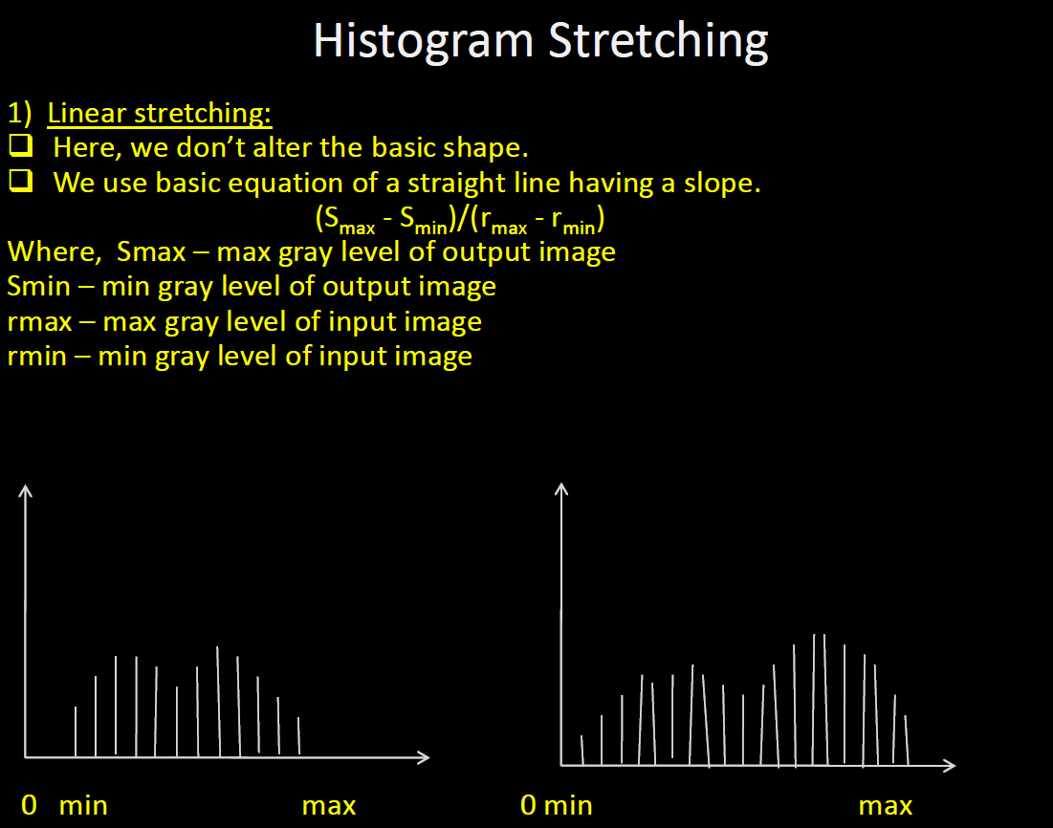
7/31/17
<number>

Slide 15
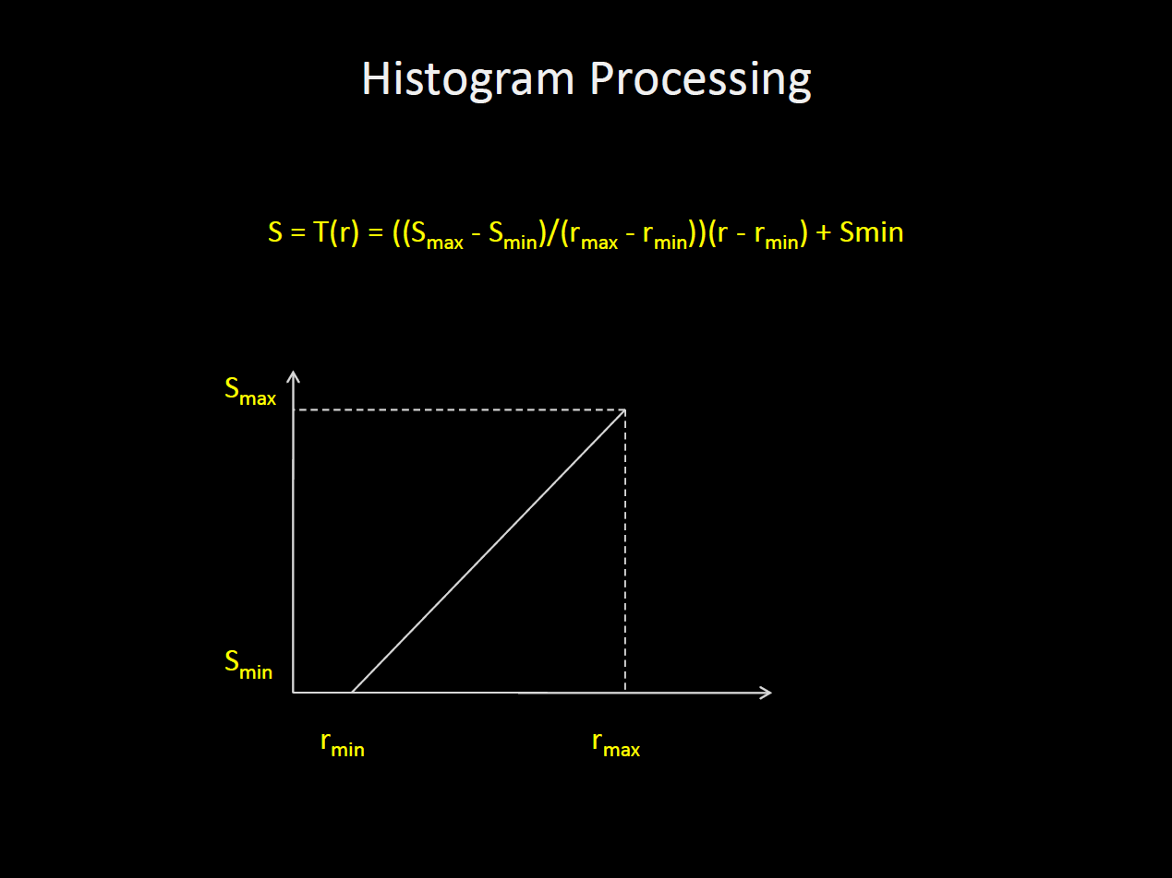
7/31/17
<number>

Slide 16
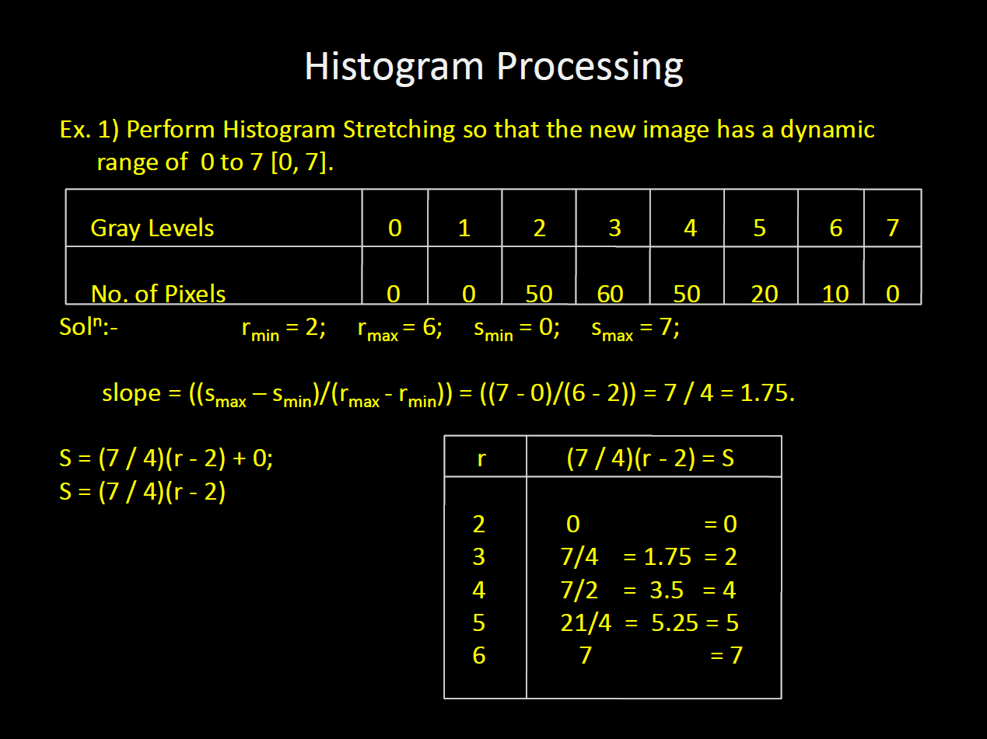
7/31/17
<number>

Slide 17
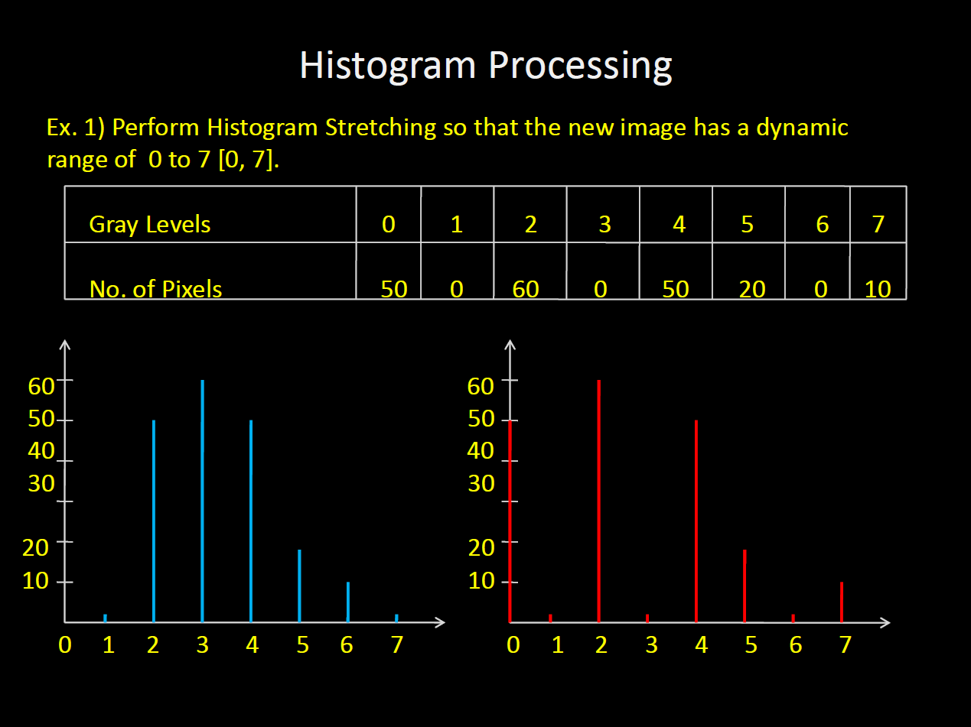
7/31/17
<number>

Slide 18
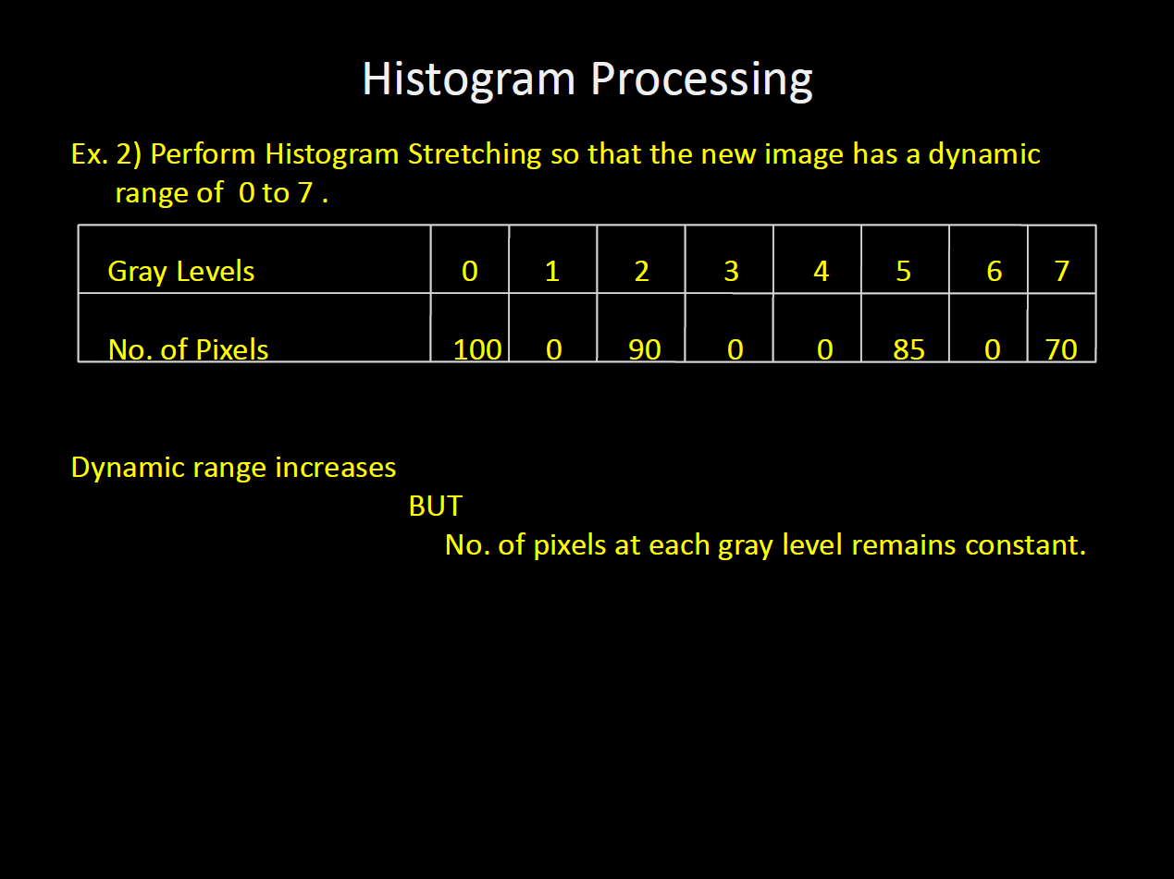
7/31/17
<number>

Slide 19
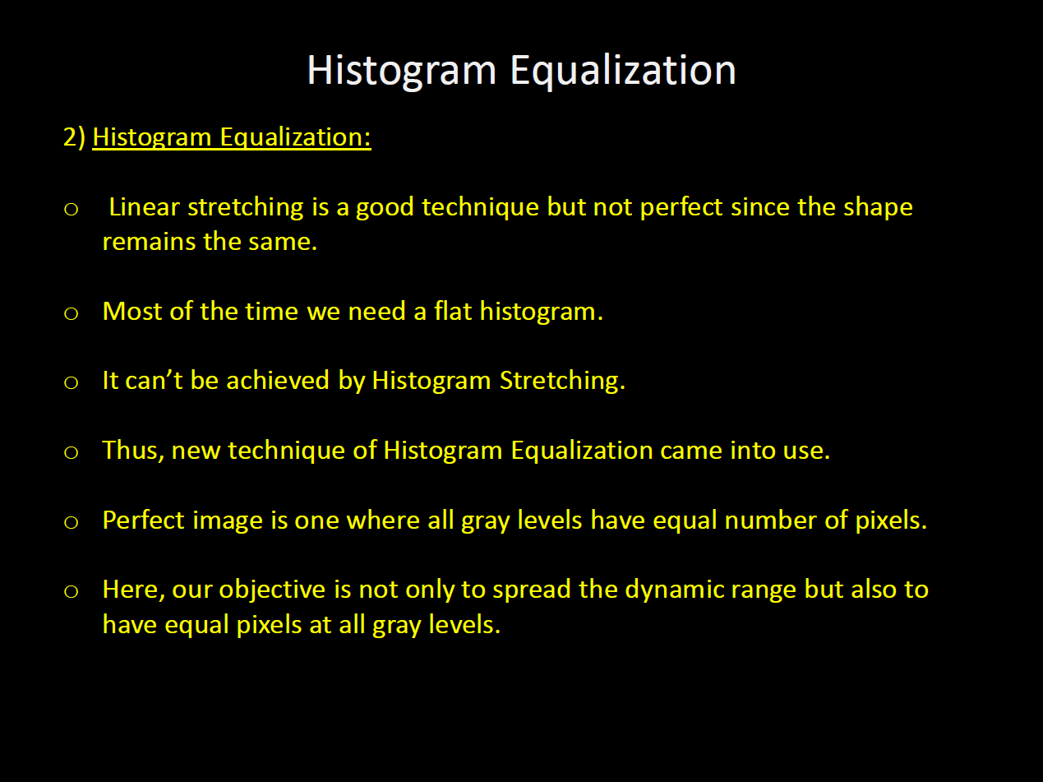
7/31/17
<number>

Slide 20
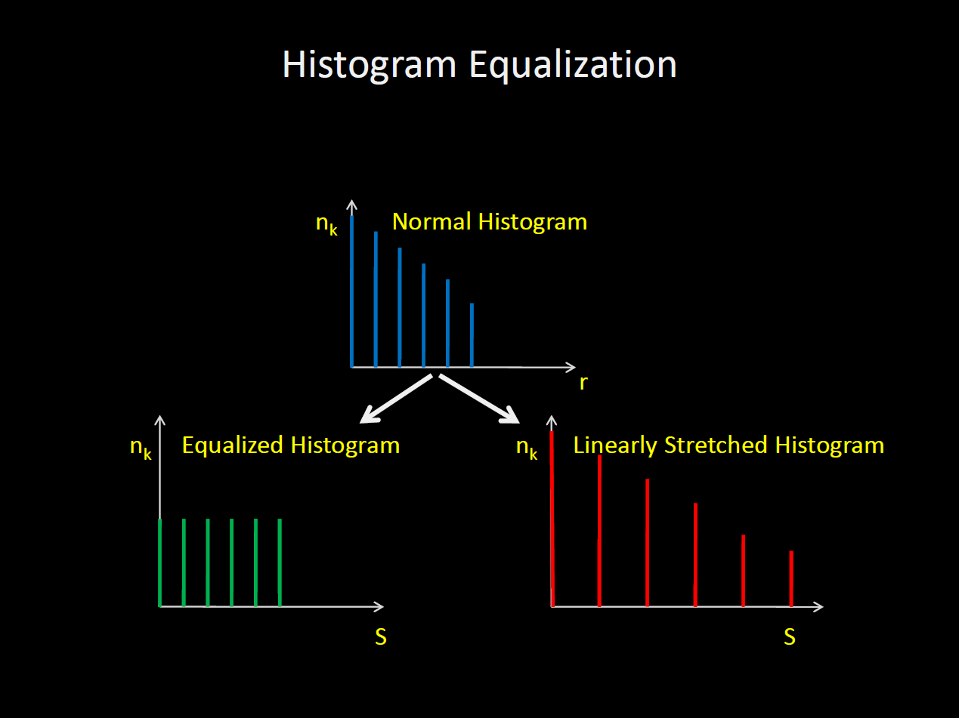
7/31/17
<number>

Slide 21
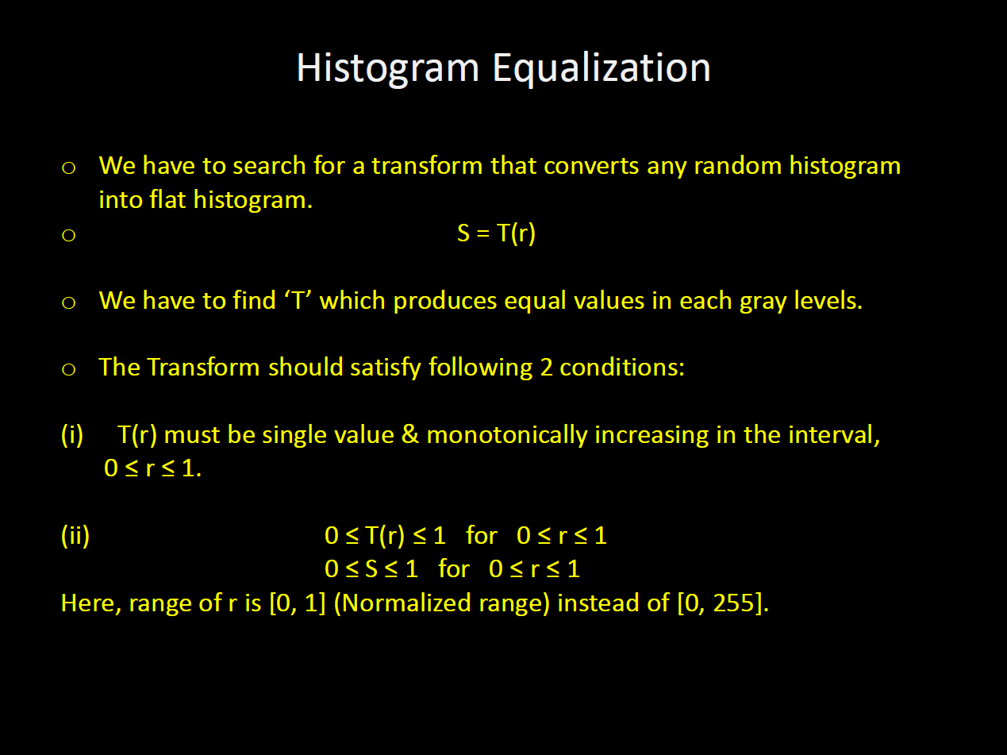
7/31/17
<number>

Slide 22
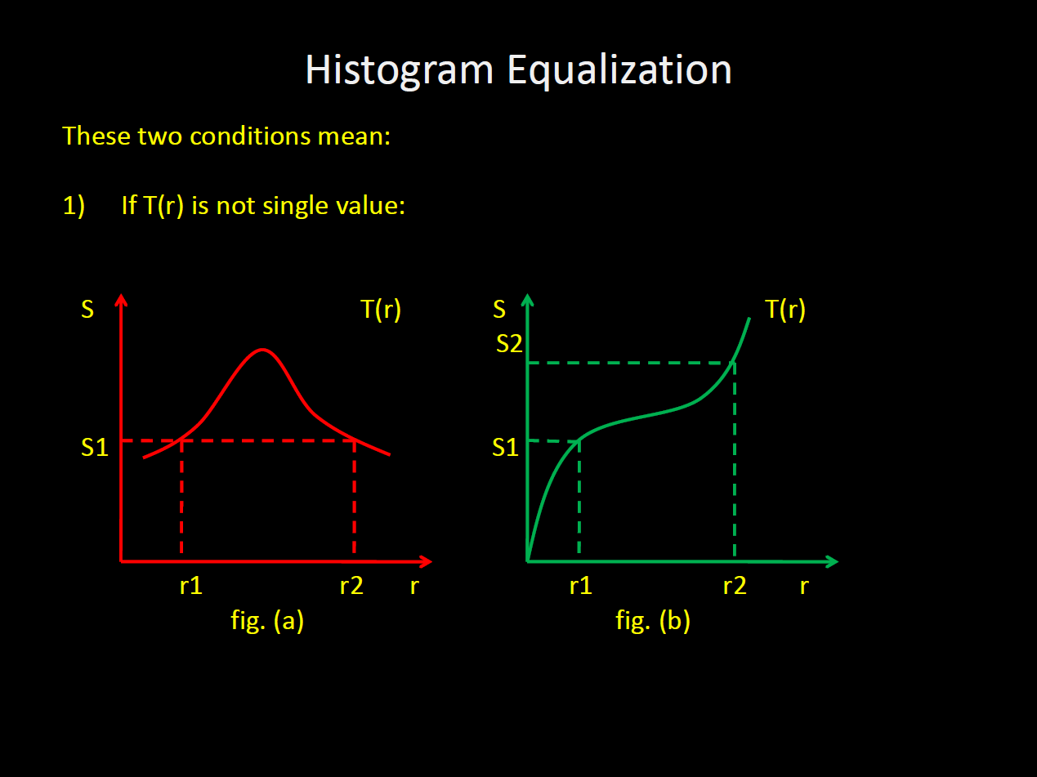
7/31/17
<number>

Slide 23
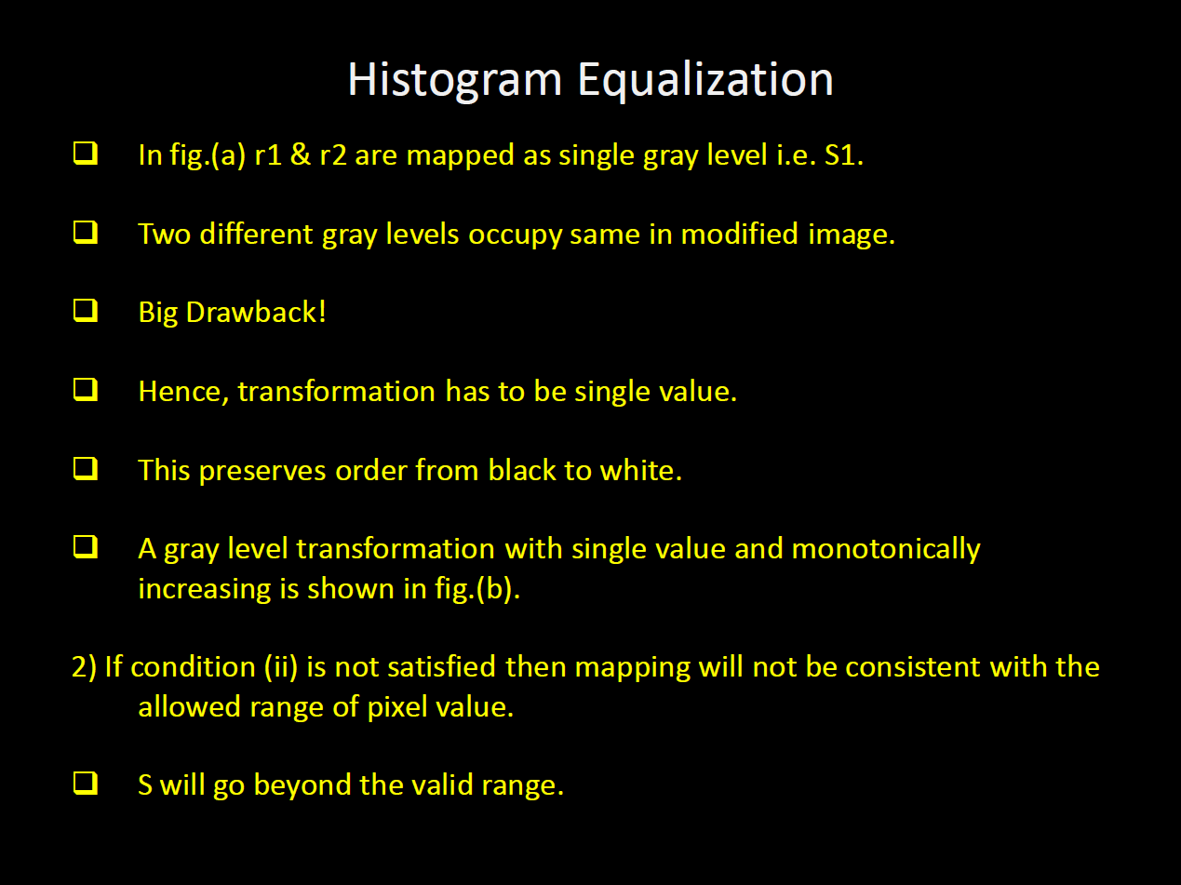
7/31/17
<number>

Slide 24
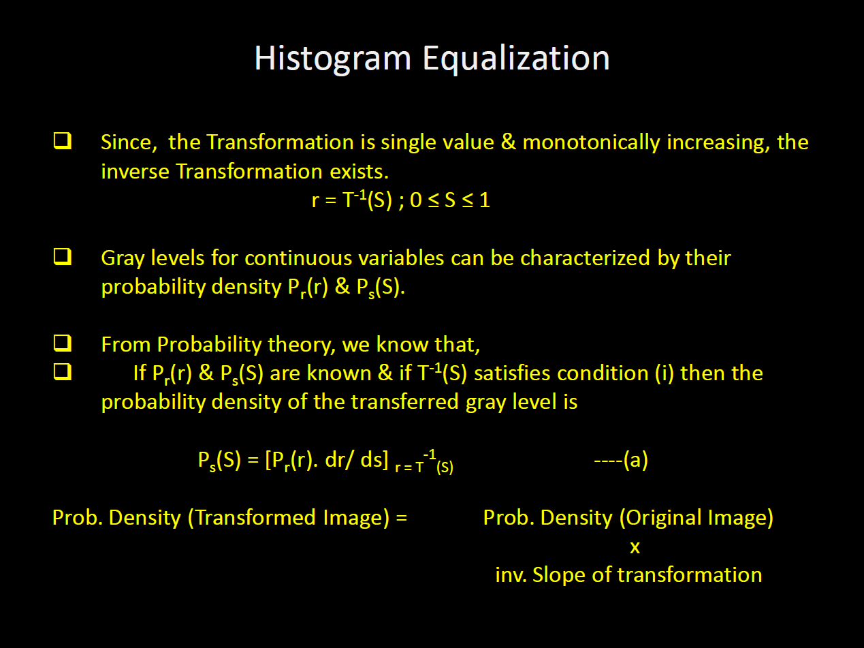
7/31/17
<number>

Slide 25
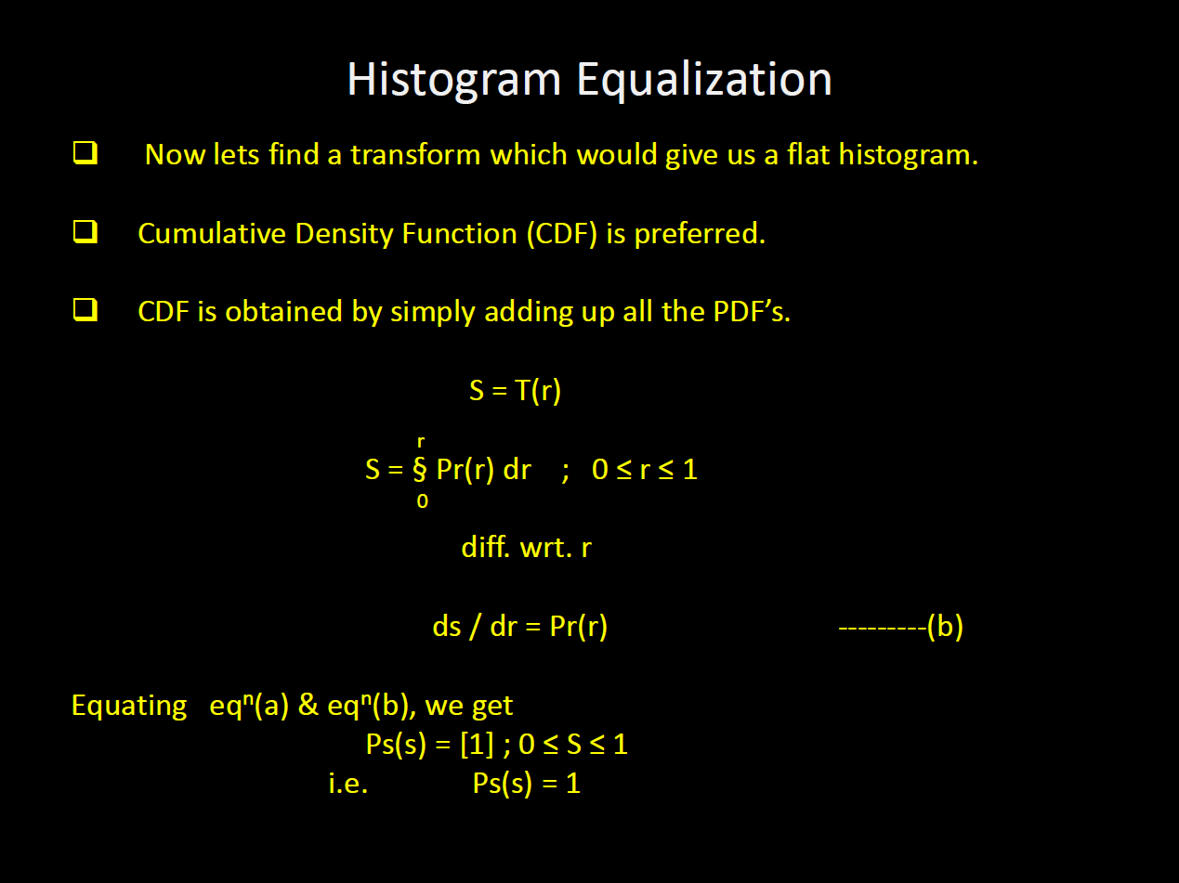
7/31/17
<number>

Slide 26
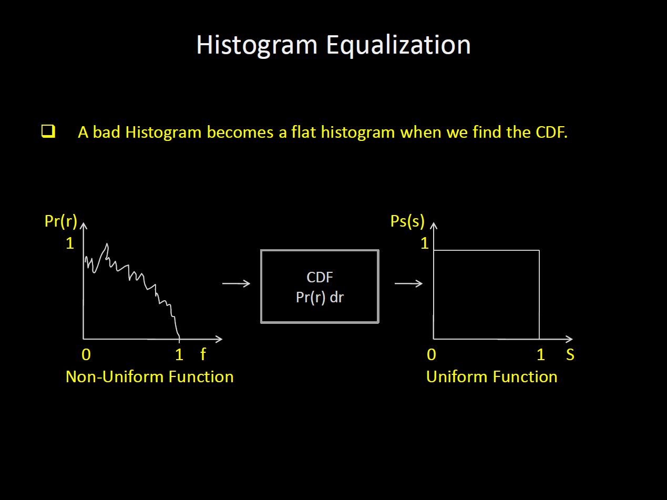
7/31/17
<number>

Slide 27
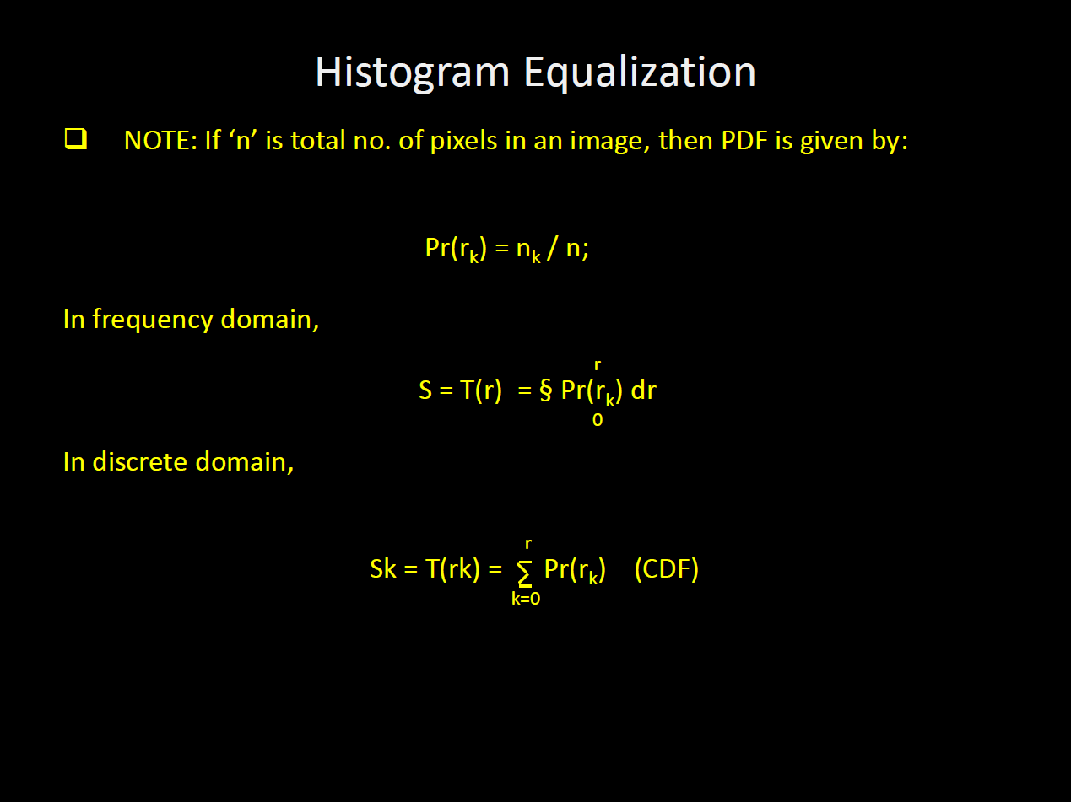
7/31/17
<number>

Slide 28
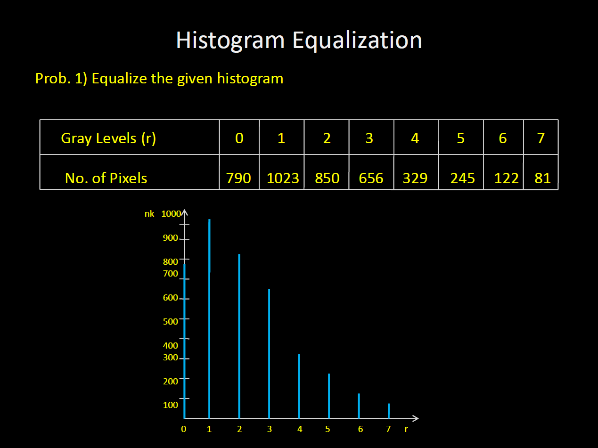
7/31/17
<number>

Slide 29
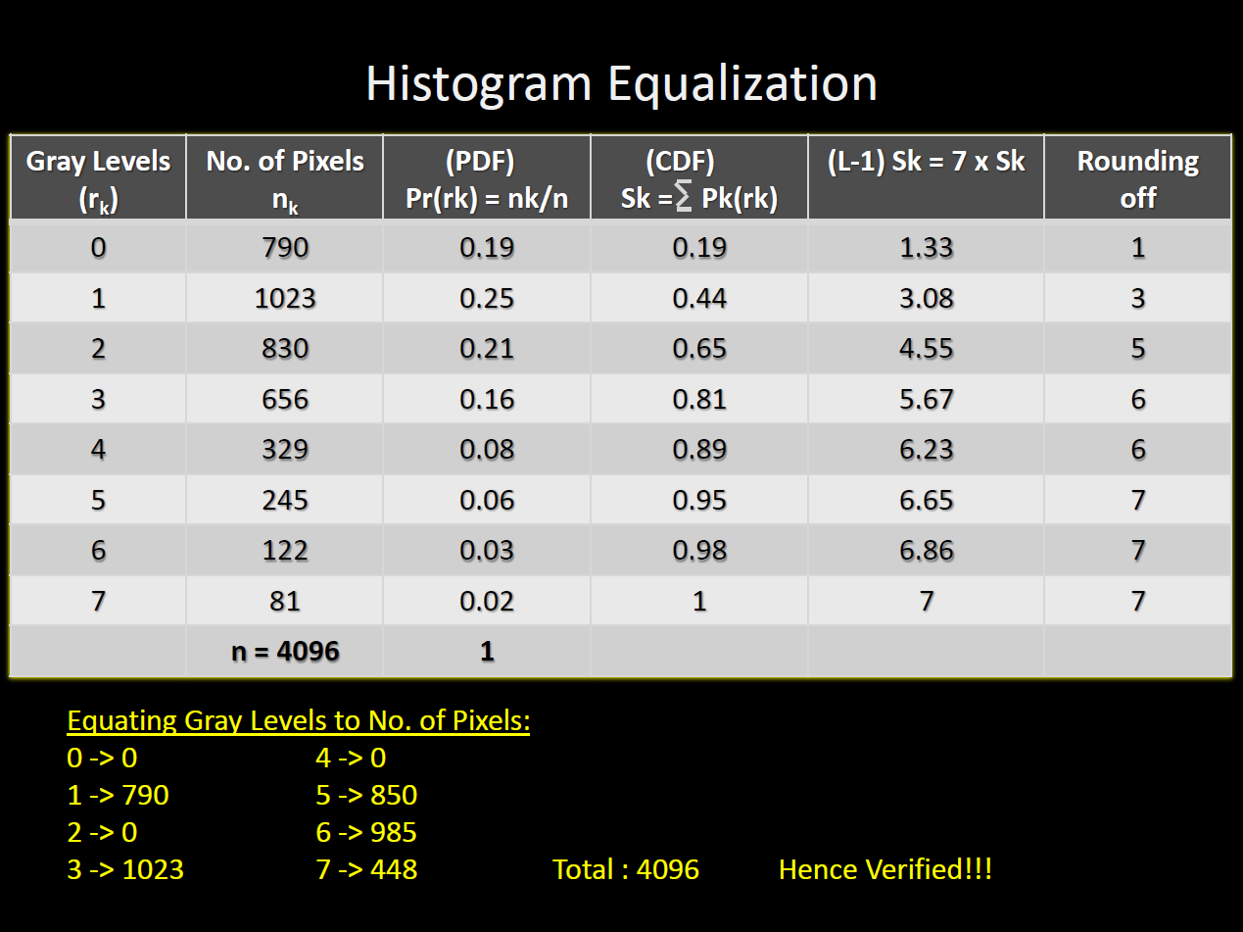
7/31/17
<number>

Slide 30
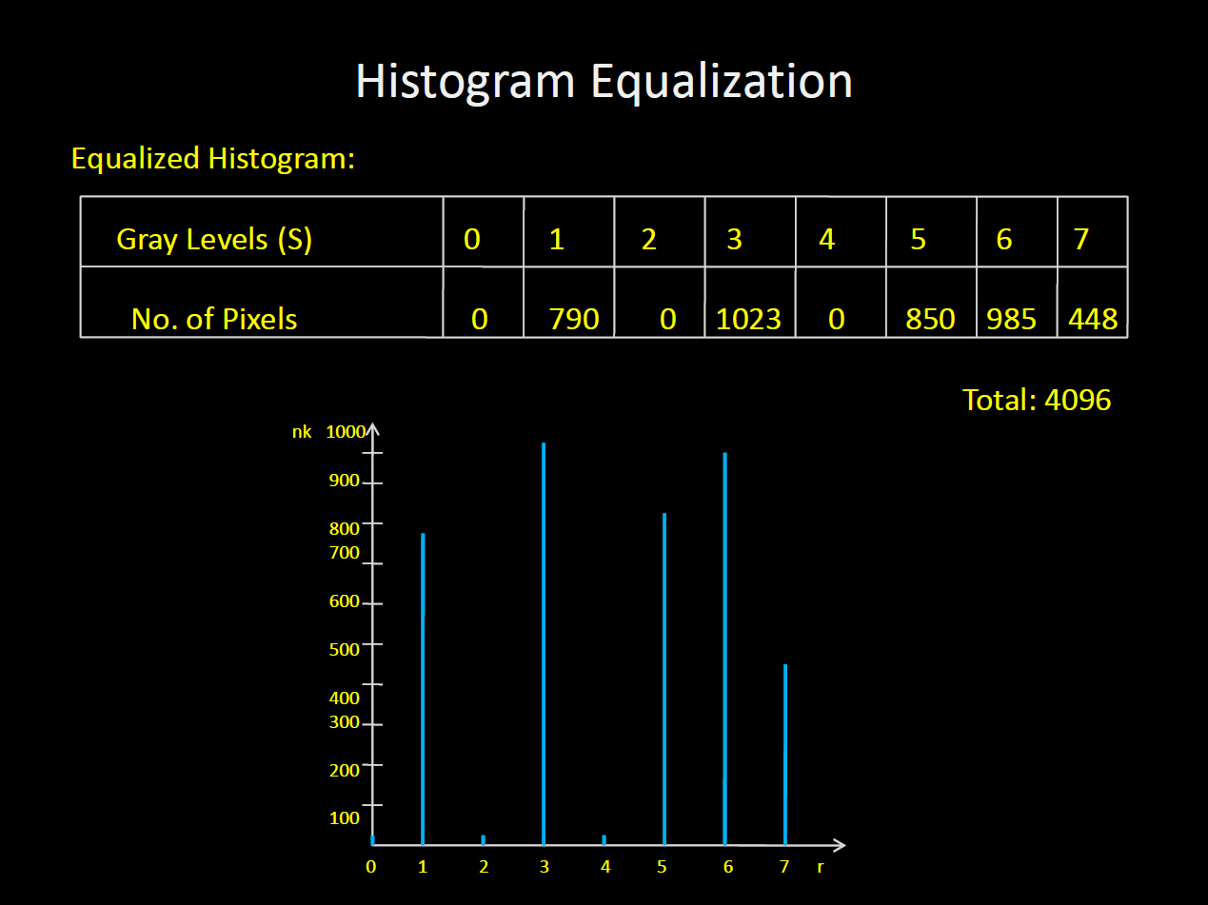
7/31/17
<number>

Slide 31
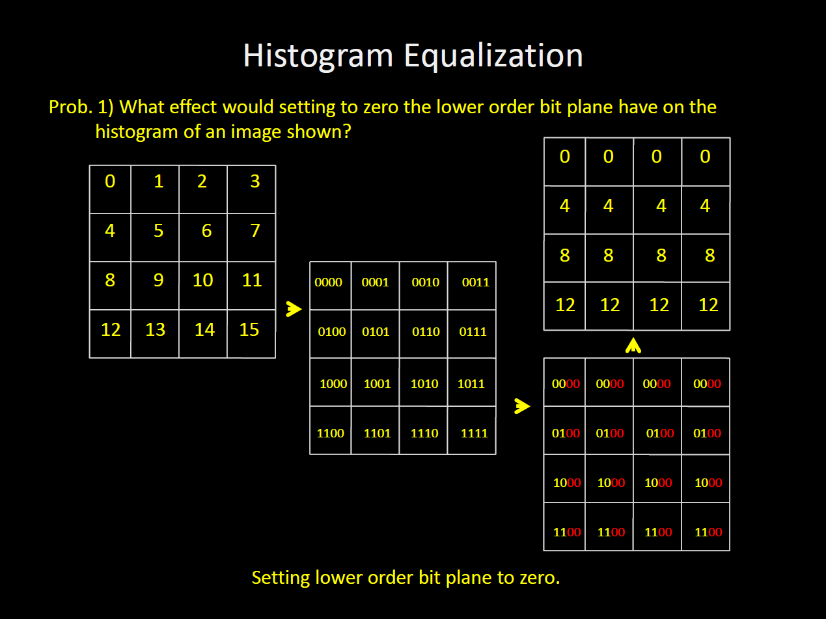
7/31/17
<number>

Slide 32
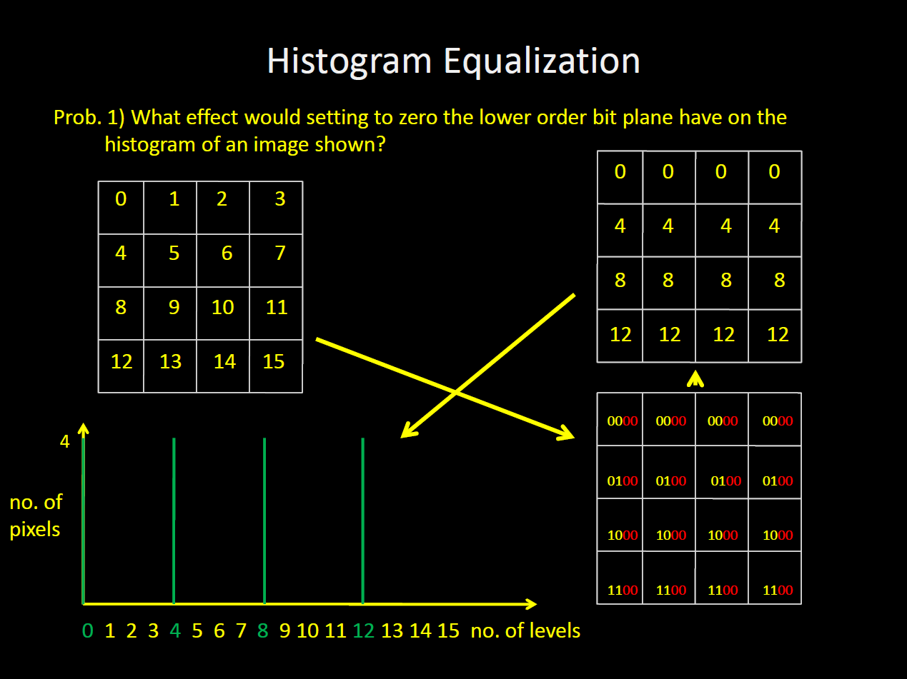
7/31/17
<number>

Slide 33
Histogram Equalization
High-contrast images are often desirable from a visual perspective
High-contrast images have histograms where the components cover a wide dynamic range
Distribution of pixels are close to a uniform distribution
Intuitively, low-contrast images can be enhanced by transforming its pixel distribution into a uniform distribution to achieve high contrast
7/31/17
<number>

Slide 34
Histogram Equalization
7/31/17
<number>

Slide 35
Local Histogram Equalization
Global approach good for overall contrast enhancement
However, there may be cases where it is necessary to enhance details over small areas in image
Solution: perform histogram equalization over a small neighborhood
7/31/17
<number>

Slide 36
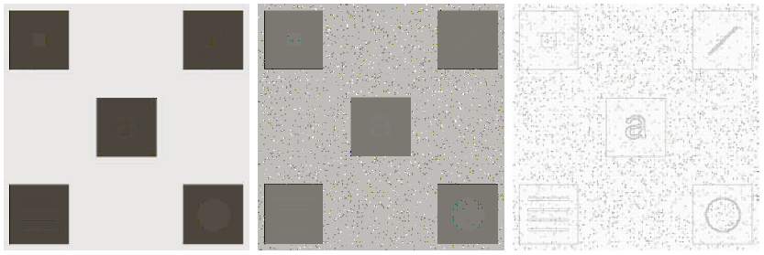
Local Histogram Equalization:
Example
7/31/17
<number>

Slide 37
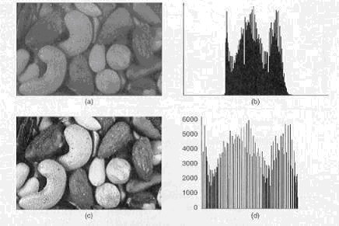
7/31/17
<number>

Slide 38
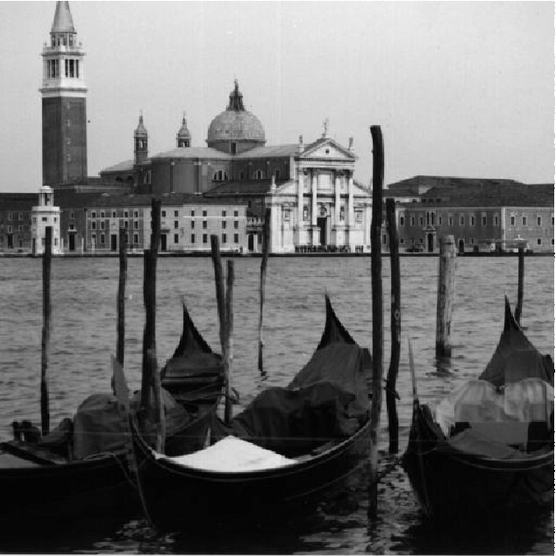
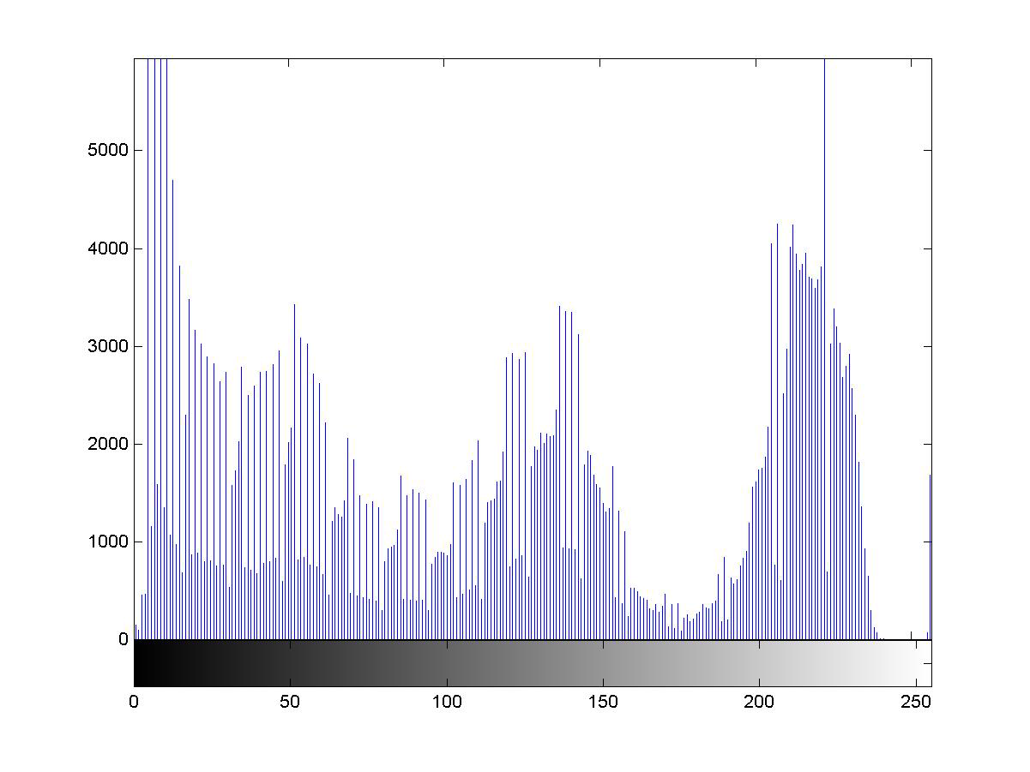
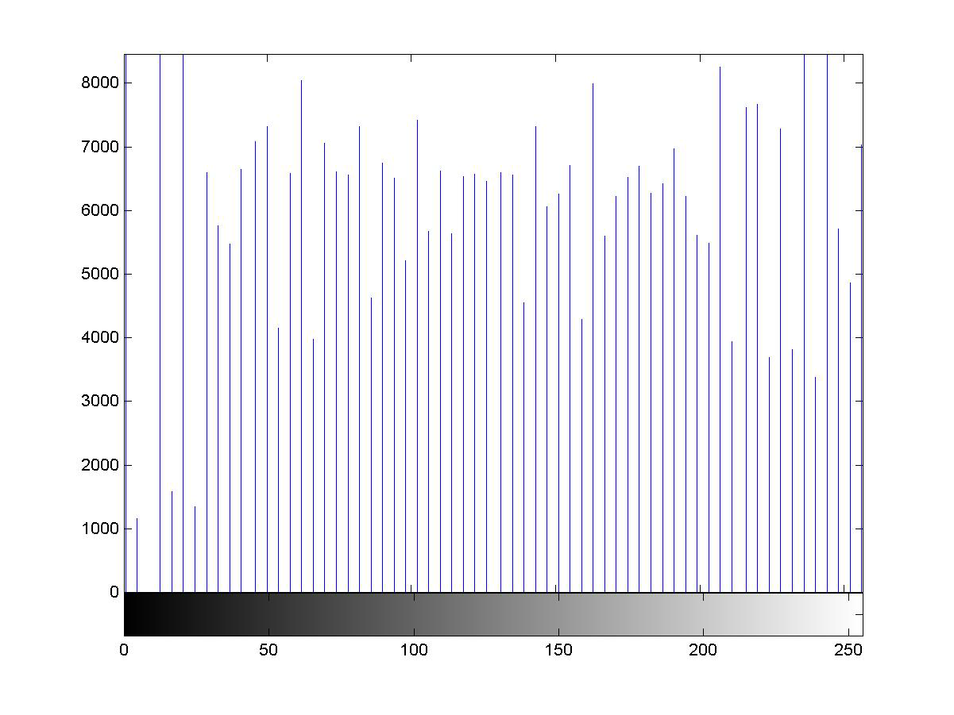
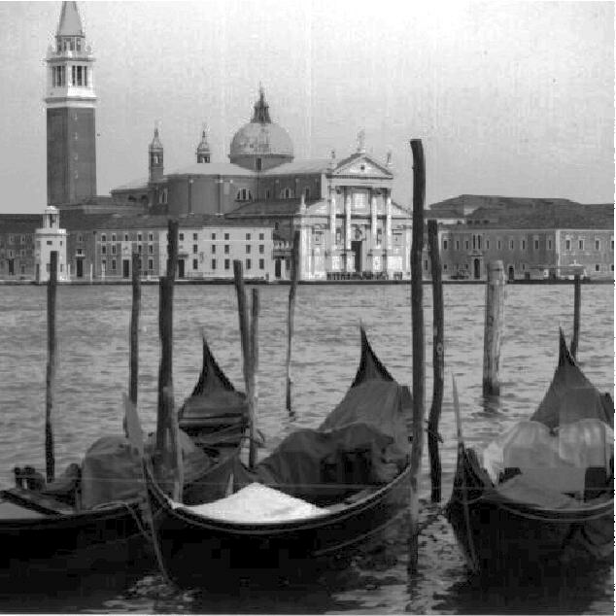
7/31/17
<number>

Slide 39
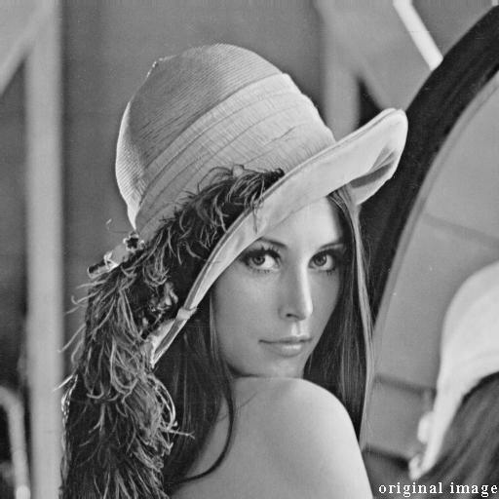
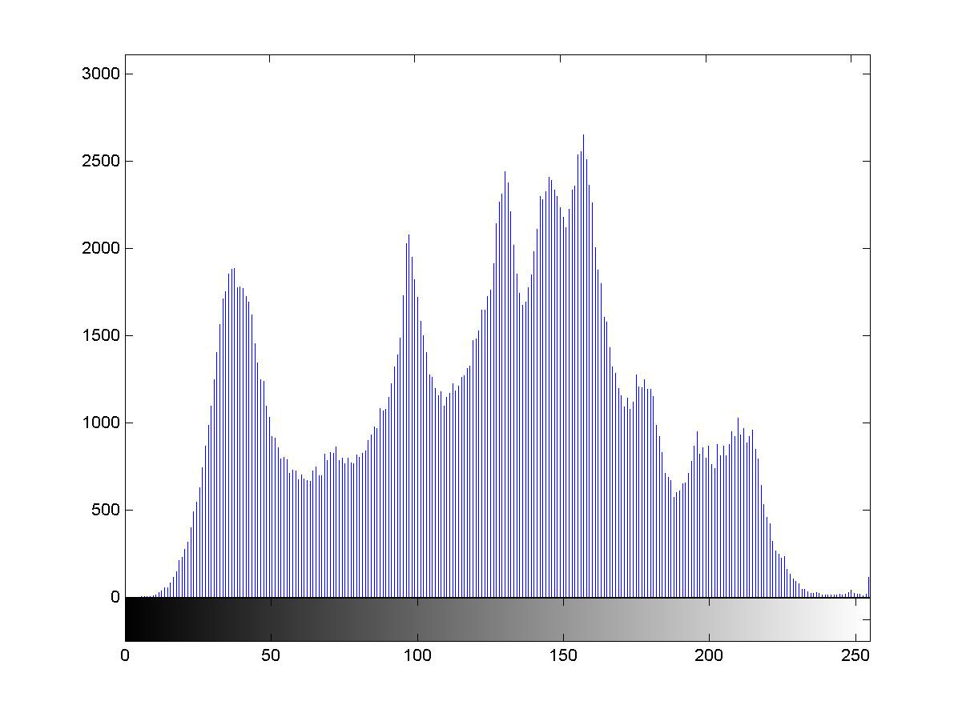

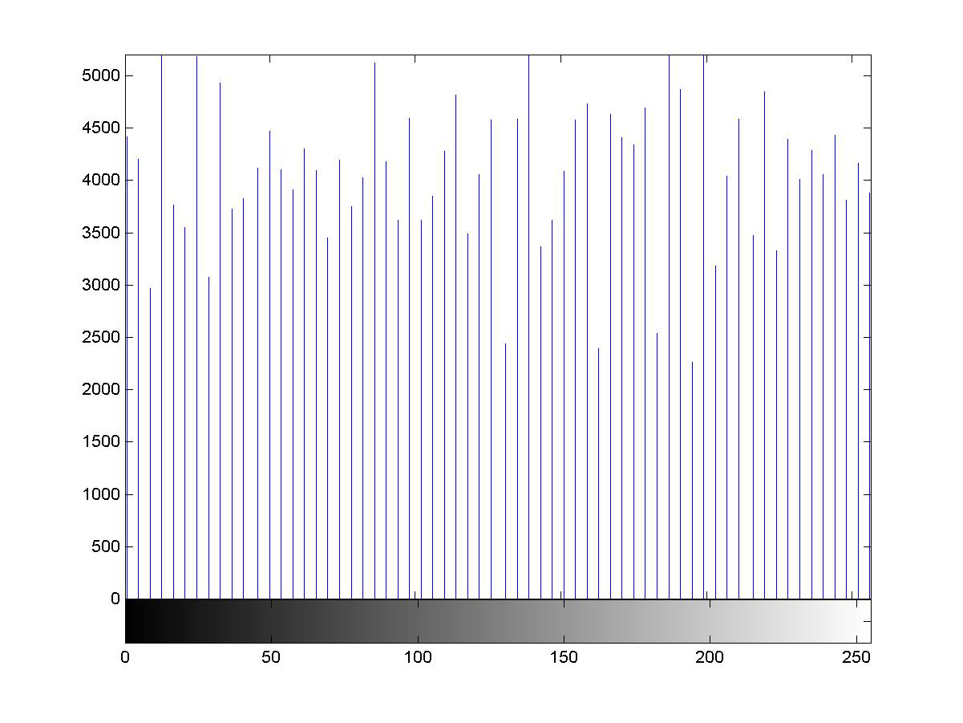
7/31/17
<number>

Slide 40
Discussion on Histogram equalization
• This method is completely automatic.
• Inverse transformation rk=T-1(sk) satisfies both the conditions (onto and one to
one) and hence can be used in the continuous case
• In case of discrete histogram, it is possible if the input
image has all the gray levels.
ALGORITHM
INPUT: Input image
OUTPUT: Output image after equalization
1. Compute histogram h(xi)
2. Calculate normalized sum of histogram (CDF)
3. Transform input image to output image
7/31/17
<number>

Slide 41
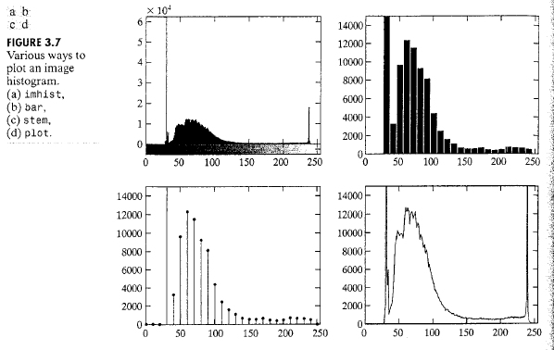
Histogram in MATLAB
h = imhist (f, b)
Where f, is the input image, h is the histogram, b is number of bins (tick marks) used in forming the histogram (b = 255 is the default)
normalized histogram
p = imhist (f, b) / numel(f)
numel (f): a MATLAB function that gives the number of elements in array f (i.e. the number of pixels in an image)
bar (horz, v, width)
7/31/17
<number>

Slide 42
7/31/17
<number>

Slide 43
Other ways to display Histograms
BAR
>> h = imhist(f);
>>h1 = h(1:10:256);
>> horz = 1:10:256;
>> bar (horz, h1);
>> axis ([0 255 0 15000])
>> set (gca, ‘xtick’, 0:50:255)
>>set (gca, ‘ytick’, 0:2000:15000);
AXIS
axis ([horizmin horzmax vertmin vertmax])
gca: get current axes (the axes of the figure last displayed)
xtick and ytick set the horizontal and vertical ticks in the interval;
text (xloc, yloc, ‘text string’, ‘font size’, size);
7/31/17
<number>

Slide 44
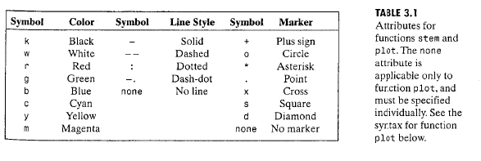
Other ways to display Histograms
STEM
stem(horz, v, ‘fill’, ‘LineStyle’);
PLOT
plot (h, ‘color-linestyle-marker’)
7/31/17
<number>

Slide 45
HISTOGRAM EQUALISATION - revision
Here, the goal is to obtain a uniform histogram for the output image.
Some features of Histogram equalization are as follows:
Histogram equalization is a point process
Histogram equalization causes a histogram with closely grouped values to spread out into a flat or equalized histogram.
• Spreading or flattening the histogram makes the dark pixels appear darker and the light pixels appear lighter.
• Histogram equalization does not operate on the histogram itself but uses the results of one histogram to transform the original image into an image that will have equalized histogram.
• Histogram equalization do not introduce new intensities in the image. Existing values will be mapped to new values keeping actual number of intensities in the resulting image
equal or less than the original number of intensities.
7/31/17
<number>

Slide 46
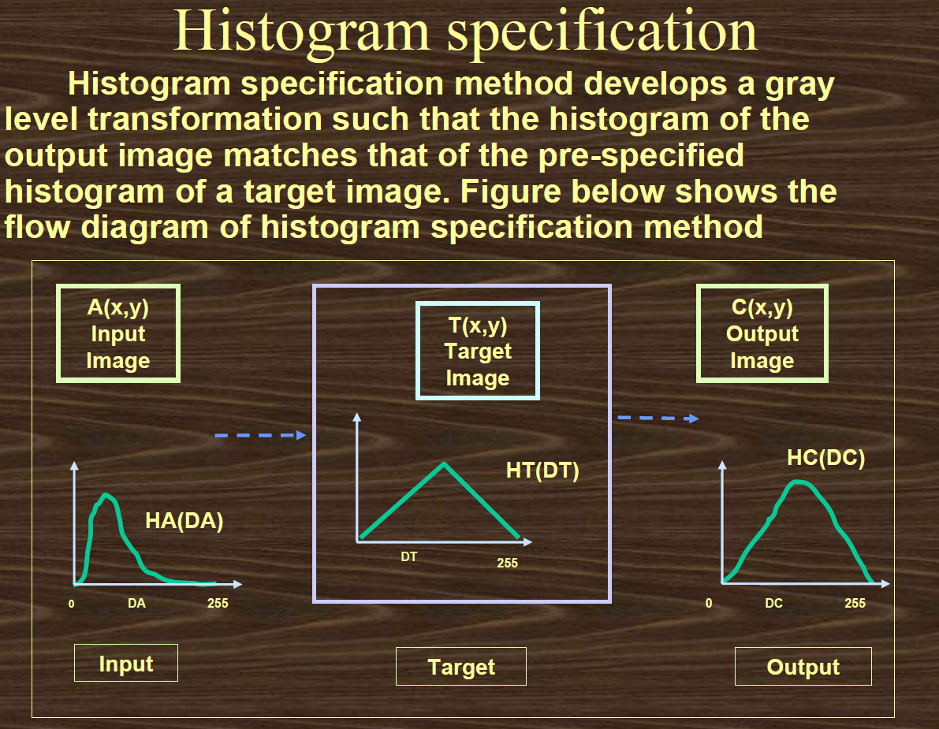
Histogram Specification
7/31/17
<number>

Slide 47
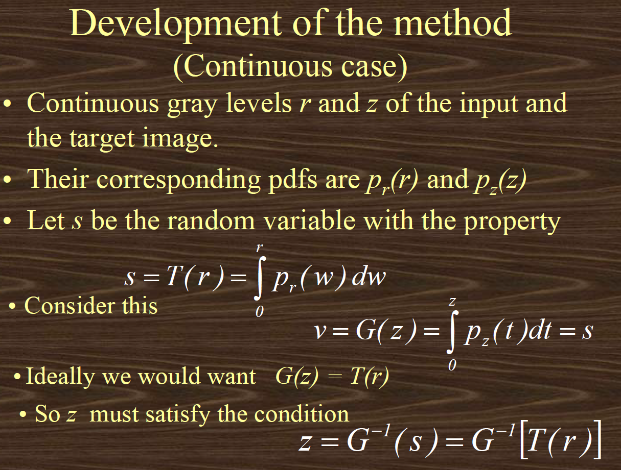
7/31/17
<number>

Slide 48
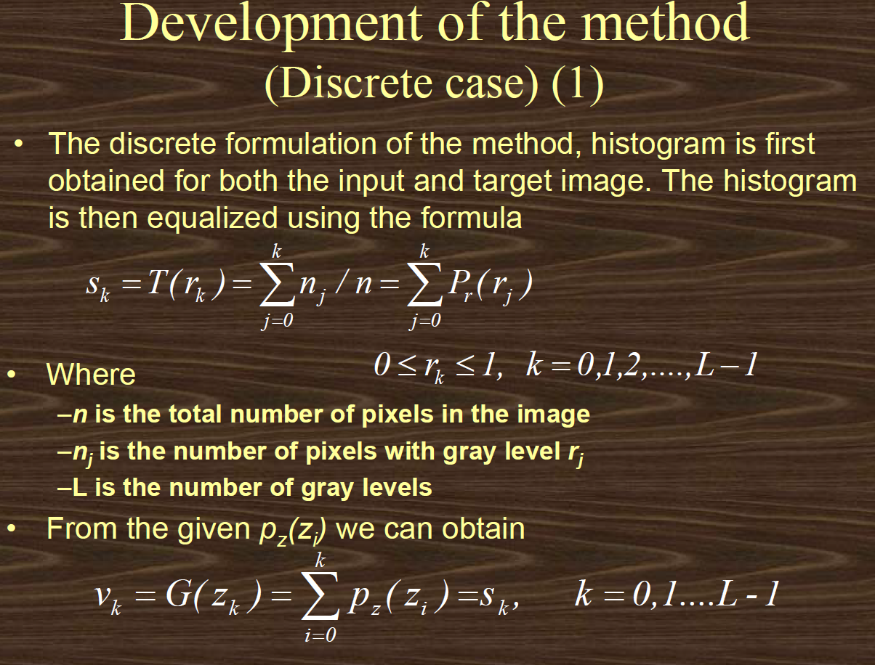
7/31/17
<number>

Slide 49
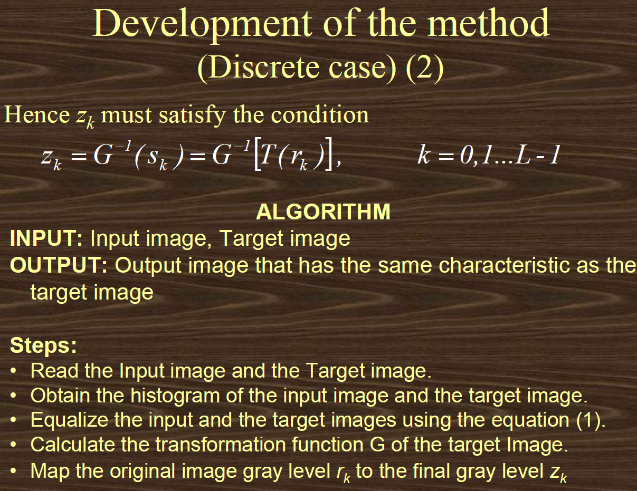
7/31/17
<number>

Slide 50

7/31/17
<number>

Slide 51

7/31/17
<number>

Slide 52

7/31/17
<number>

Slide 53

7/31/17
<number>

Slide 54

7/31/17
<number>

Slide 55

7/31/17
<number>

Slide 56

7/31/17
<number>

Slide 57

7/31/17
<number>

Slide 58

7/31/17
<number>

Slide 59

7/31/17
<number>

Slide 60
Thank you
Notes:
7/31/17
<number>

